Slide 1
CSIT558_01SP25 | ASSIGNMENT-4: PREDICTIVE DATA MINING
BY
Chaudhari, Amishaben Natavarbhai [CWID:50129394]
Javed, Syed Mehrose [CWID: 50128848]
Subhani, Muhammad Kamal [CWID: 50136417]
Thangavel Sathiyamoorthy, Punithan [CWID: 50135877]
Venkata Appala Manoj Muvvala [CWID: 50122981 ]

Slide 2

DESCRIPTION
Dataset:
This dataset contains medical data including the patient characteristics such as age, sex, blood pressure levels, and cholesterol levels, as well as the drugs that they responded to. The dataset can be used to predict the most suitable drug for future patients based on their characteristics.
Overview:
The dataset consists of attributes of the patients that influence drug response. It contains 3 categorical (Sex, BP, Cholesterol) and 2 numerical (Age, Na_to_K) attributes. The target variable (Drug) is the prescribed drug having categorical values of 5 different drugs (A, B, C, X, and Y) to be recommended.
Potential Applications:
Medical Decision Trees for drug prediction; Feature Analysis to determine which factors (e.g., blood pressure, cholesterol) are most influential; Healthcare AI Applications for AI-powered drug recommendation systems.

Slide 3
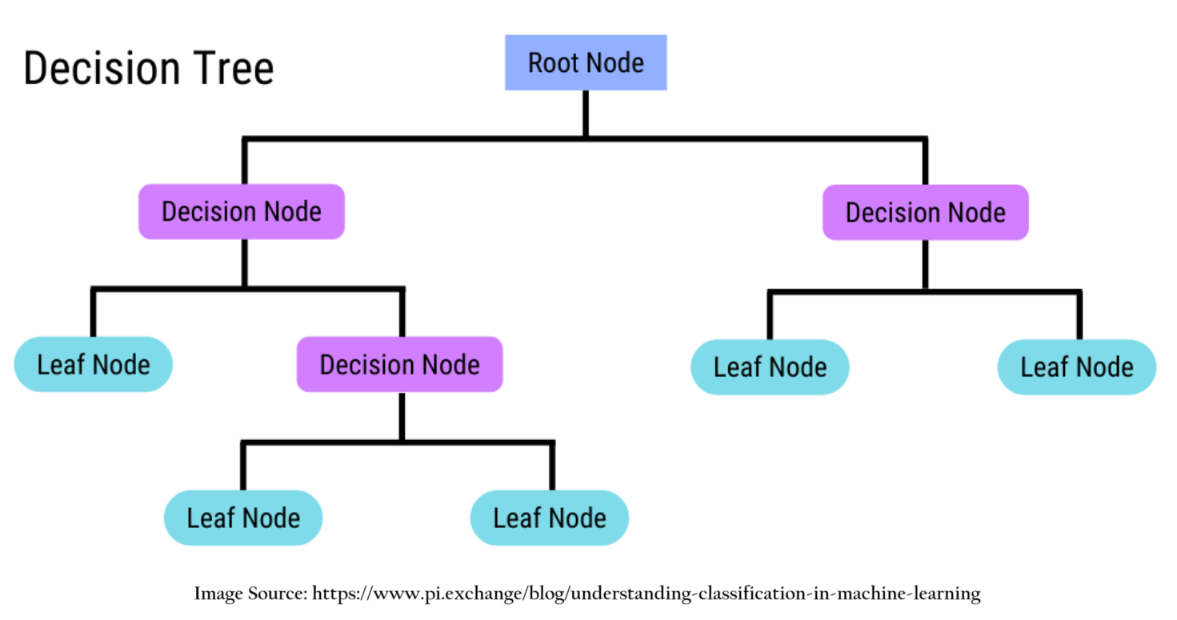
DATA MINING TECHNIQUE
Decision Tree Classifier:
A Decision Tree Classifier is a supervised machine learning algorithm used for classification tasks, where data is split into a tree-like structure based on feature values. It recursively divides the dataset into subsets, creating decision rules that lead to specific class predictions at the leaf nodes.
Why Decision Tree Classifier?
A Decision Tree Classifier is well-suited for this dataset because it can very effectively analyze various attributes of the patients and determine the most appropriate drug for them by creating a functioning tree based on the sequential decisions it makes on basis of the relevant features. Additionally, it requires minimal preprocessing and is reliable for fast and precise decision-making.

Slide 4
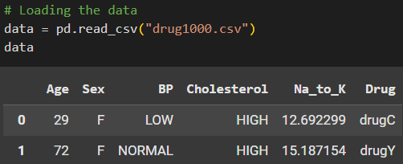
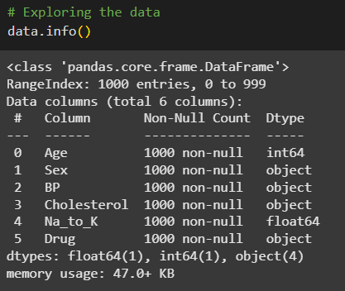
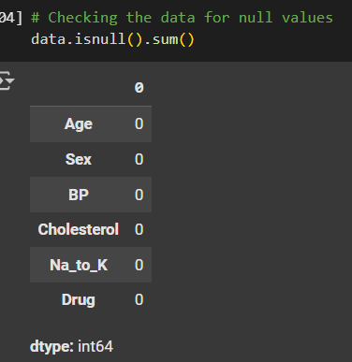
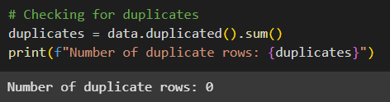
DATA LOADING AND CLEANING
Data Loading:
D
Duplicate check:
As part of Data Cleaning process, we
Explored the data and column data types
Checked for missing values
Checked for duplicate values
Data Description: Null Check:

Slide 5
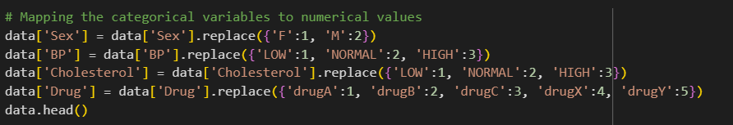
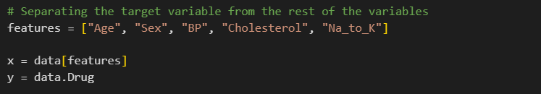

EXECUTION: PREPARATION
Mapping the categorical variables to a numerical value.
Separating the target variable - Drug, from the rest of the dataset.
Splitting the dataset into train and test datasets for modelling.

Slide 6
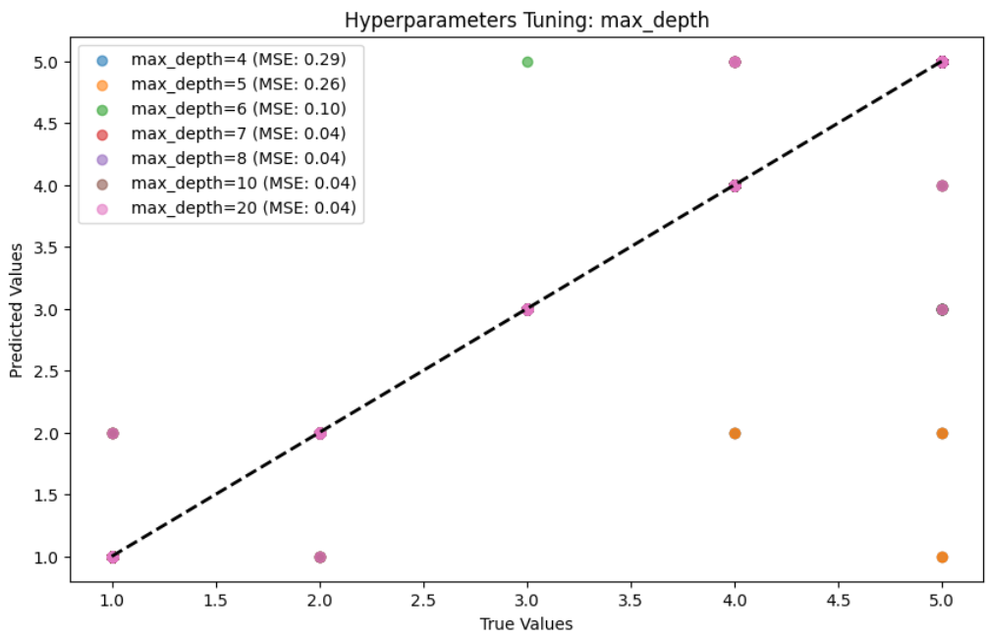
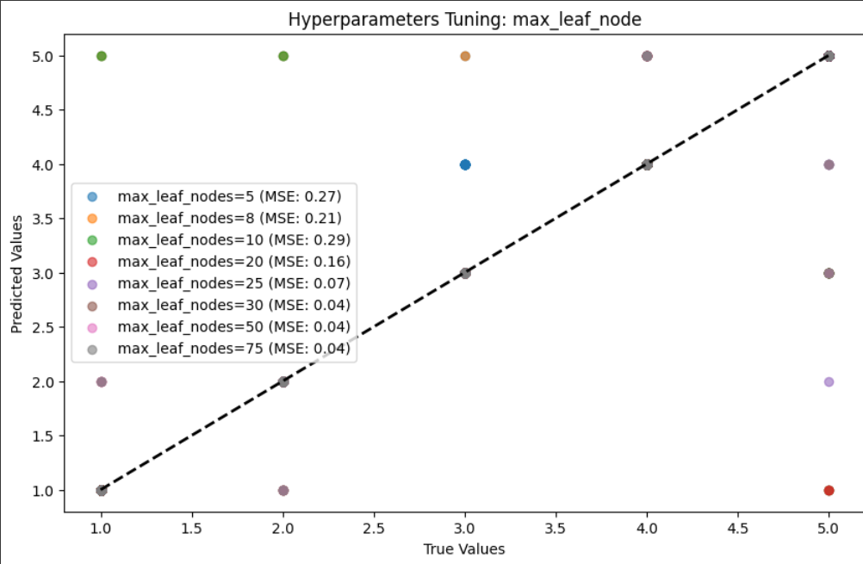
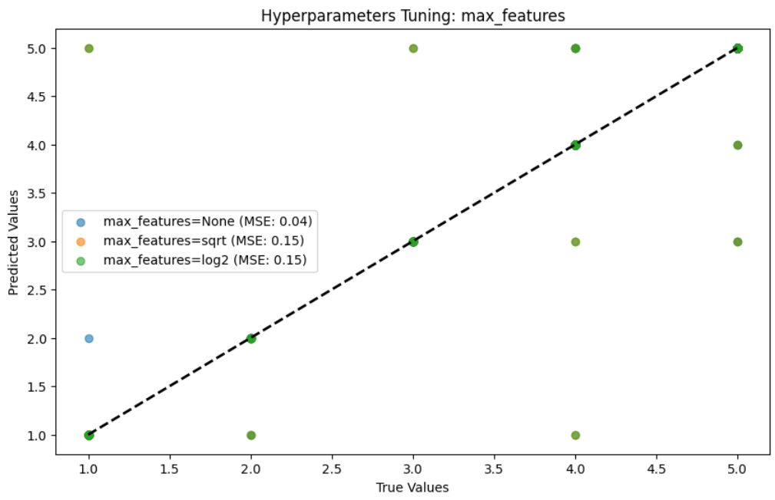
EXECUTION: HYPERPARAMETER TUNING
Testing with different values of some of the key hyperparameters of the Decision Tree Classifier to fit the training model better with least mean squared error.
The values thus chosen were:
max_depth = 7 max_leaf_nodes = 30 max_features = None

Slide 7
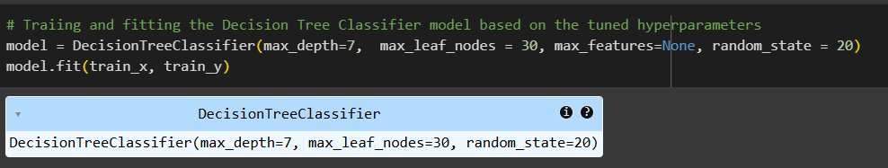
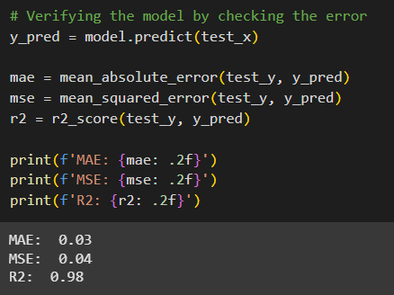
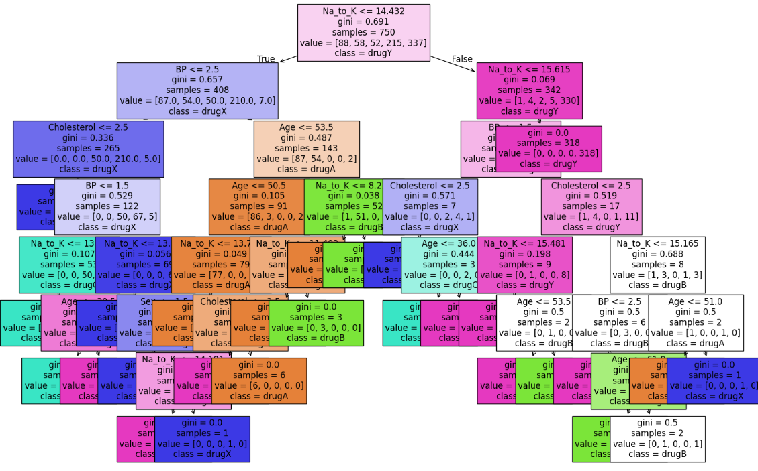
EXECUTION: CLASSIFIER MODEL
Best Model:
Decision Tree Classifier model has been implemented based on the tuned hyperparameters.
Decision Tree:
Verification:
The model seems to predict the drug pretty accurately since the error (MAE and MSE) is nearly 0 and R2 is almost 1.

Slide 8
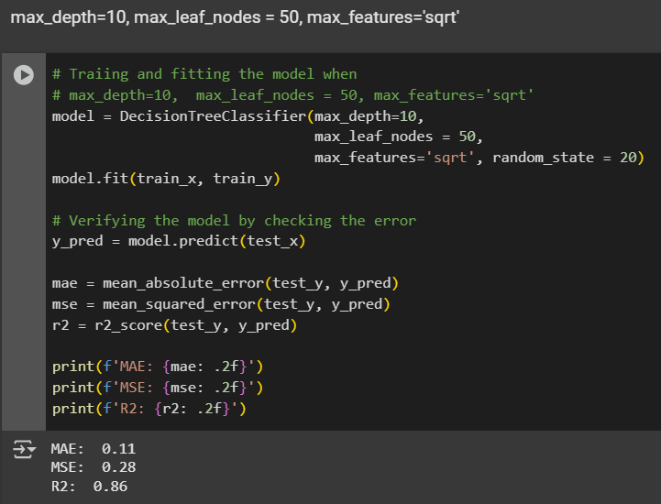
EXECUTION: MODEL EXPERIMENTATION
Testing with other acceptable values of some of the hyperparameters to check if they perform better than our selected model.
Experiment-1 with
max_depth = 10 max_leaf_nodes = 50 max_features = sqrt
Verification:
MAE = 0.11 [Best: 0.03] MSE = 0.28 [Best: 0.04] R2 = 0.86 [Best: 0.98]

Slide 9
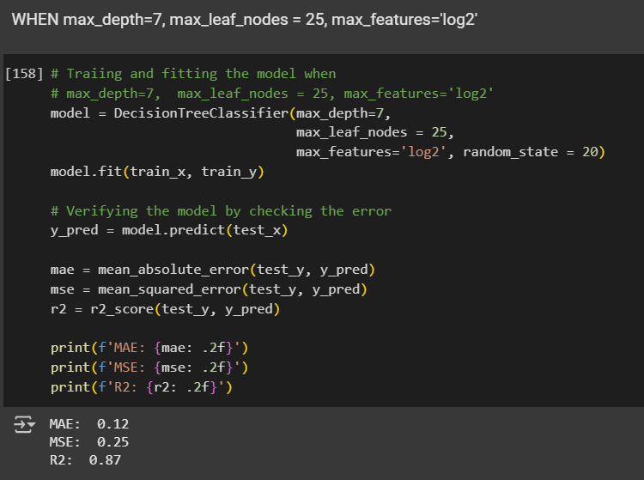
EXECUTION: MODEL EXPERIMENTATION
Testing with other acceptable values of some of the hyperparameters to check if they perform better than our selected model.
Experiment-2 with
max_depth = 7 max_leaf_nodes = 25 max_features = log2
Verification:
MAE = 0.12 [Best: 0.03] MSE = 0.25 [Best: 0.04] R2 = 0.87 [Best: 0.98]

Slide 10
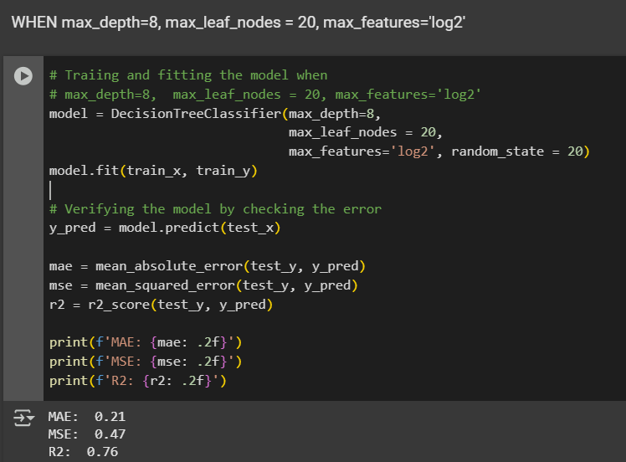
EXECUTION: MODEL EXPERIMENTATION
Testing with other acceptable values of some of the hyperparameters to check if they perform better than our selected model.
Experiment-3 with
max_depth = 8 max_leaf_nodes = 20 max_features = log2
Verification:
MAE = 0.21 [Best: 0.03] MSE = 0.47 [Best: 0.04] R2 = 0.76 [Best: 0.98]

Slide 11
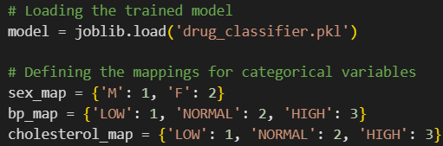
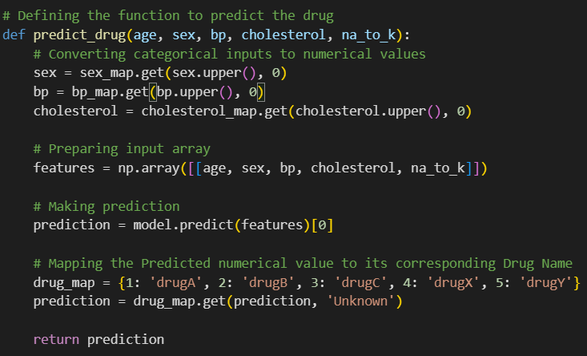
PREDICTION TOOL
Loading the trained model and defining mappings ->
Drug prediction function based on the learned model and user’s input

Slide 12
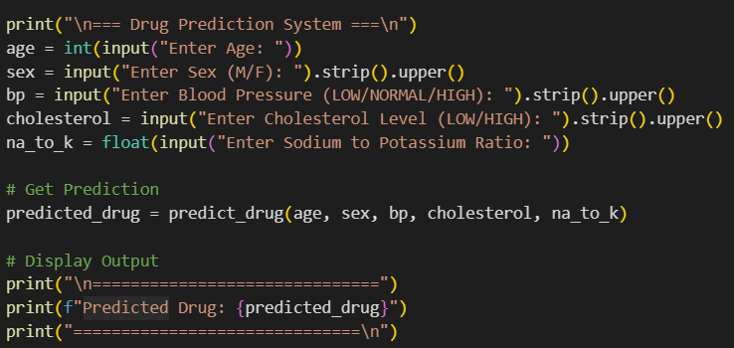
PREDICTION TOOL
User interactive drug prediction tool
Takes the input parameters from user and predicts the drug using the predict_drug function created previously

Slide 13
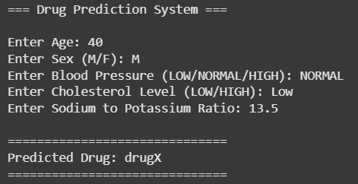
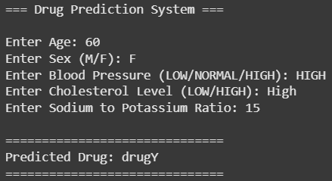
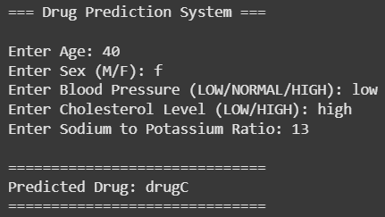
DRUG PREDICTION - DEMO
User interactive drug prediction system to predict drug for the illness
Input:
  Age, Sex, Blood Pressure, Cholesterol Level, Sodium to Potassium Ratio
Output:
  Best suitable drug for the illness as per the patient’s health indicators

Slide 14
REFERENCES
1. Dataset Source: Drug Dataset (Kaggle)
2. Software Tools Used: a. Python, Pandas, NumPy, Scikit-learn, Matplotlib, Seaborn
b. Google Colab: For code execution
3. Online Sites Explored:
a.https://scikit-learn.org/stable/modules/generated/sklearn.tree.DecisionTreeClassifier.html
b.https://www.sciencedirect.com/topics/computer-science/decision-tree-classifier
c.https://farshadabdulazeez.medium.com/understanding-decision-tree-regressor-an-in-dep
th-intuition-a1d3af182efd
4. Online Documentation & Resources:
a.Pandas: https://pandas.pydata.org/docs/
b.Scikit-learn: https://scikit-learn.org/0.21/documentation.html

